Slide 1


Slide 2


Notes:
https://docs.google.com/document/d/17oLwZ-IbbdhQa5QpBbEafUjl5BHbpP_yzOPDglfjCLc/edit

Slide 3
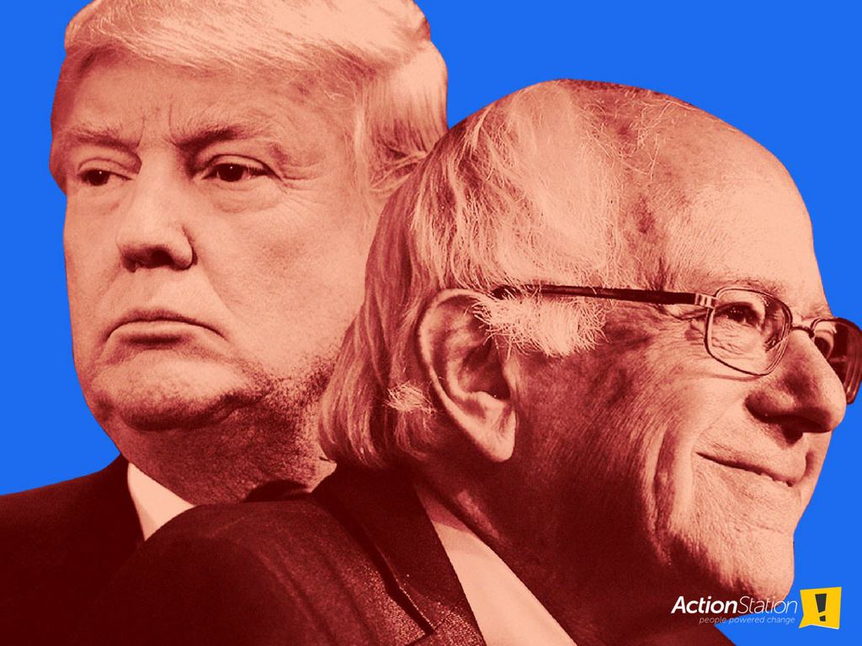

Slide 4
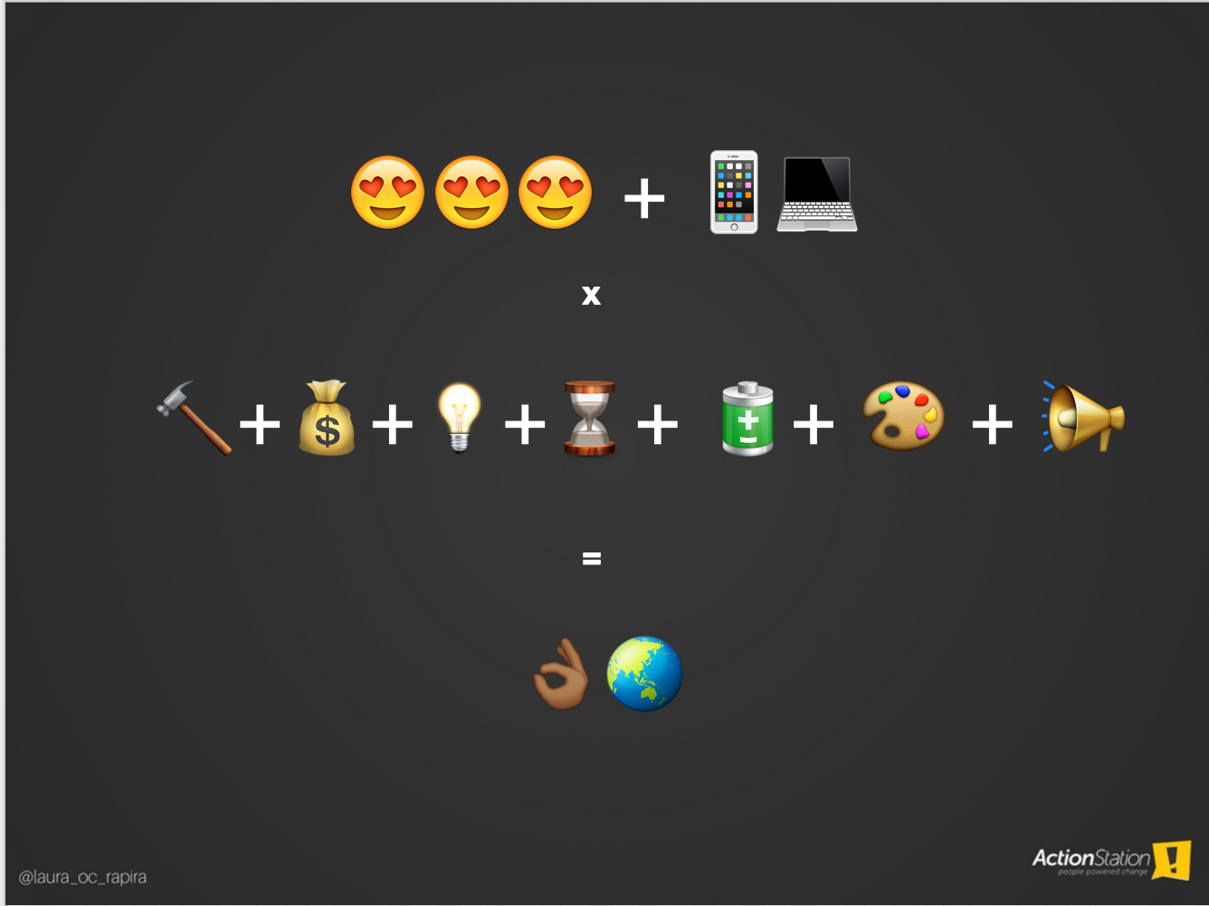

😍😍😍 + 📱💻
x
🔨+💰+💡+⌛️+ 🔋+ 🎨 + 📢
=
👌🏾🌏

Slide 5
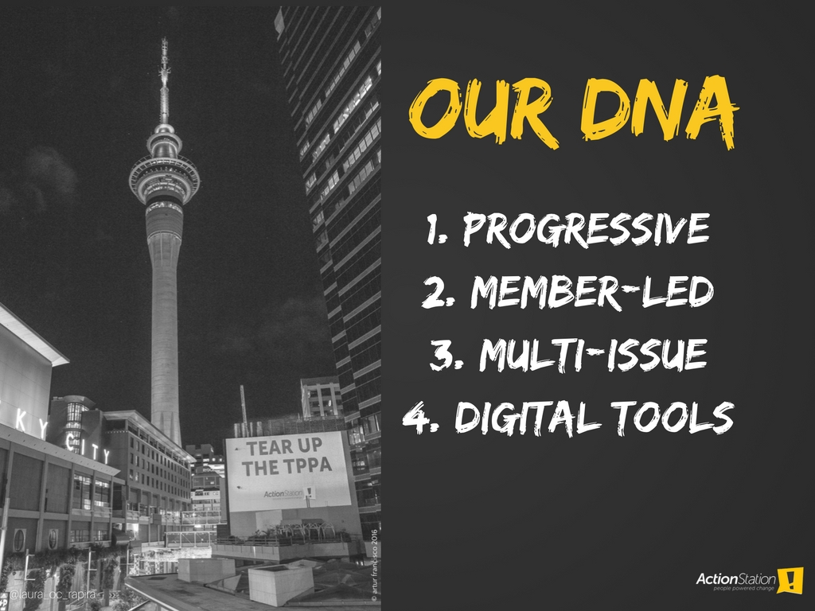

Slide 6


Slide 7
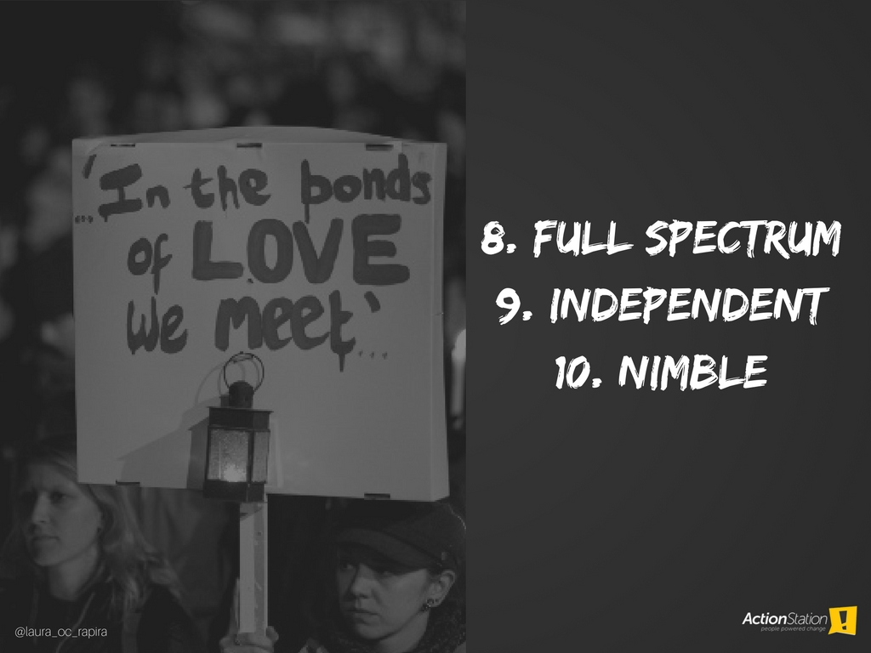

Slide 8
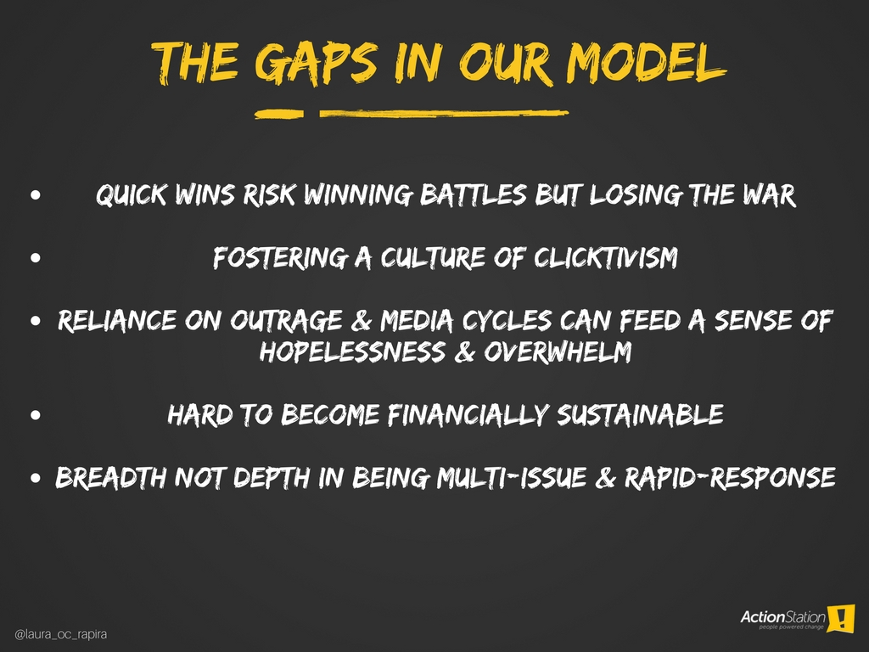

Slide 9
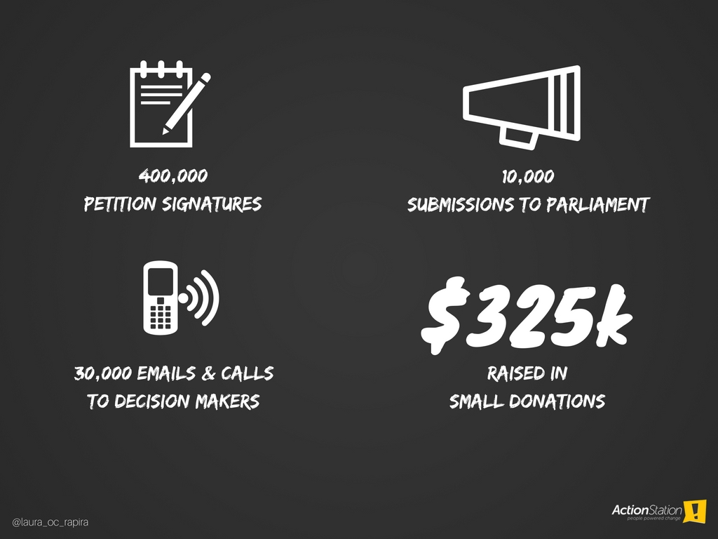

Slide 10
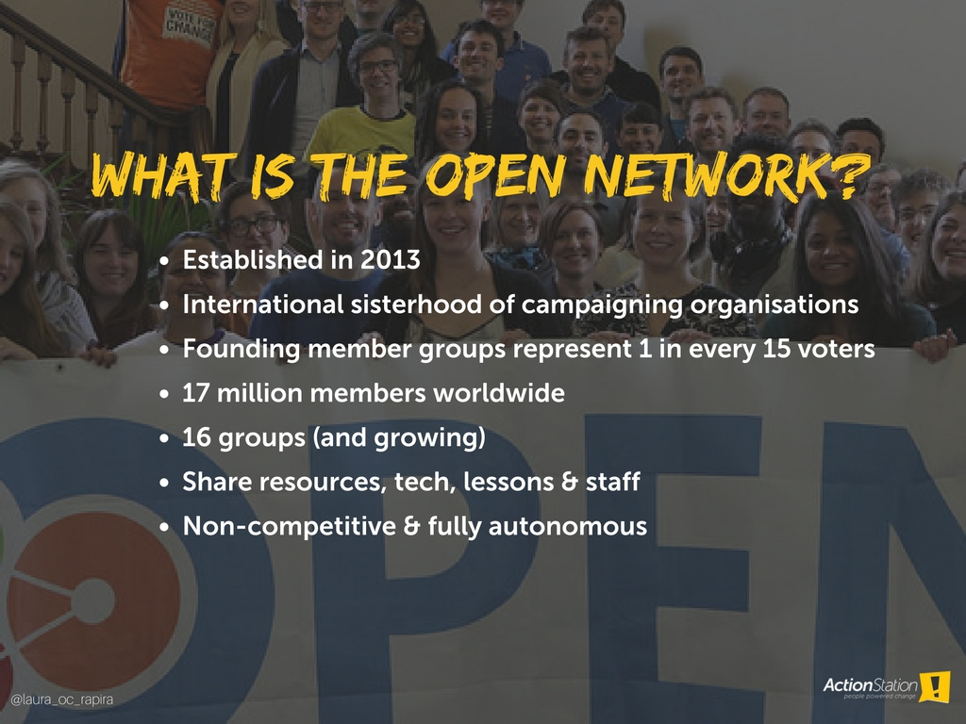

Slide 11
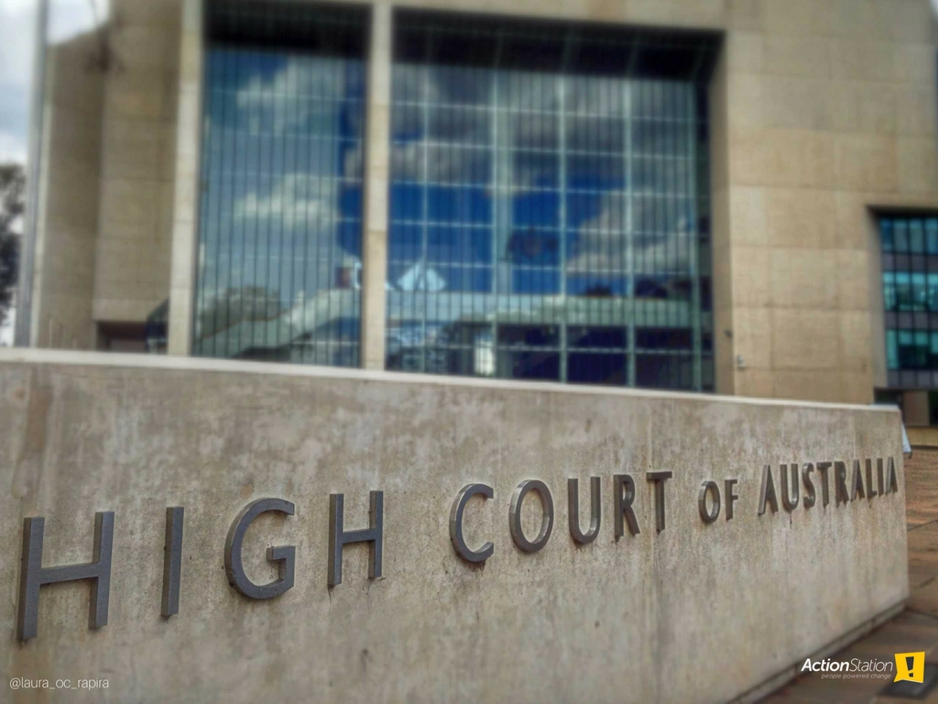

Slide 12


Slide 13
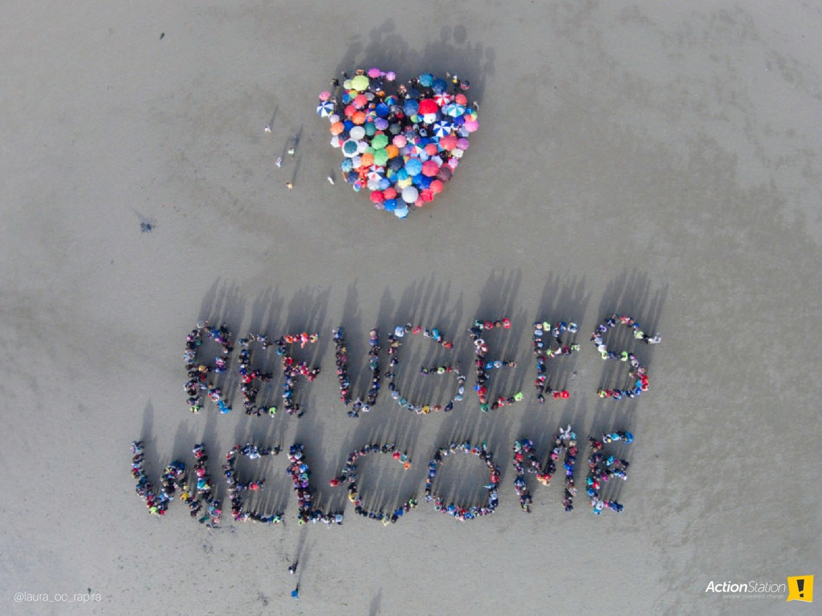

Slide 14
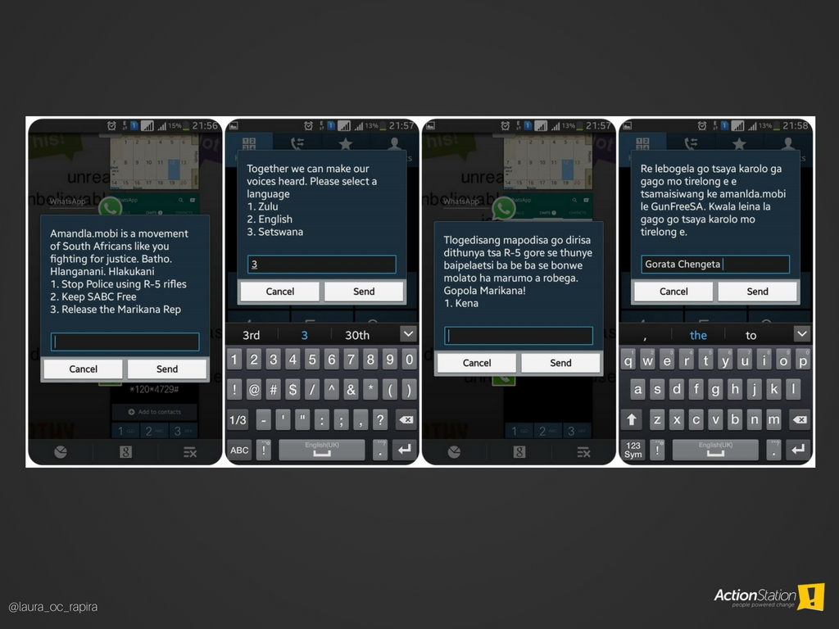

Slide 15
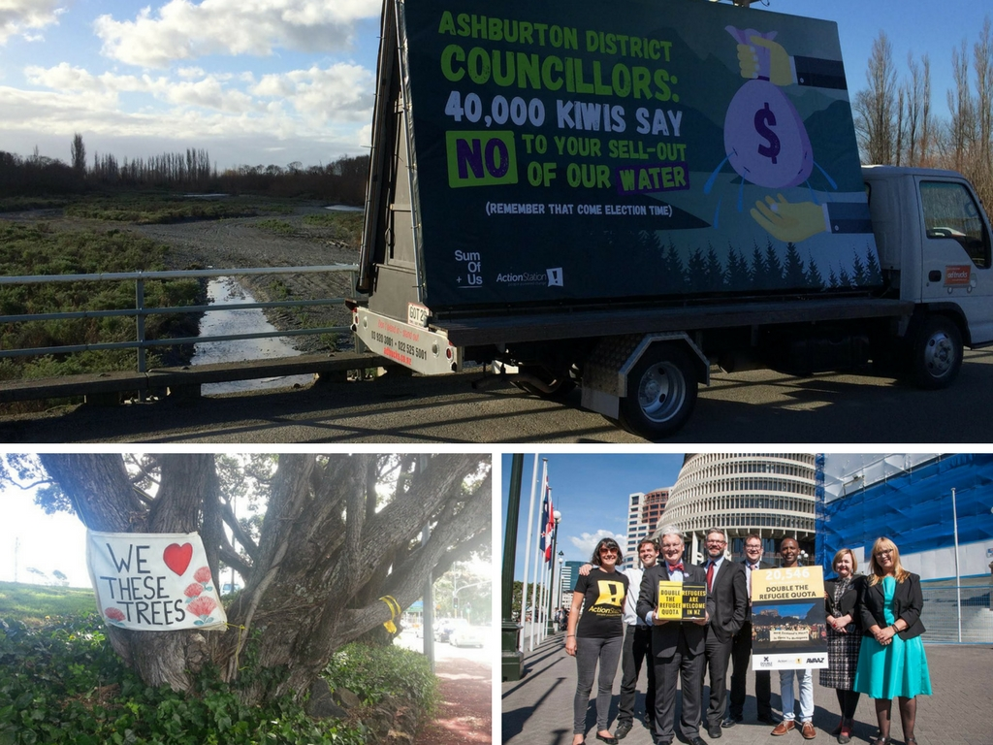

Slide 16
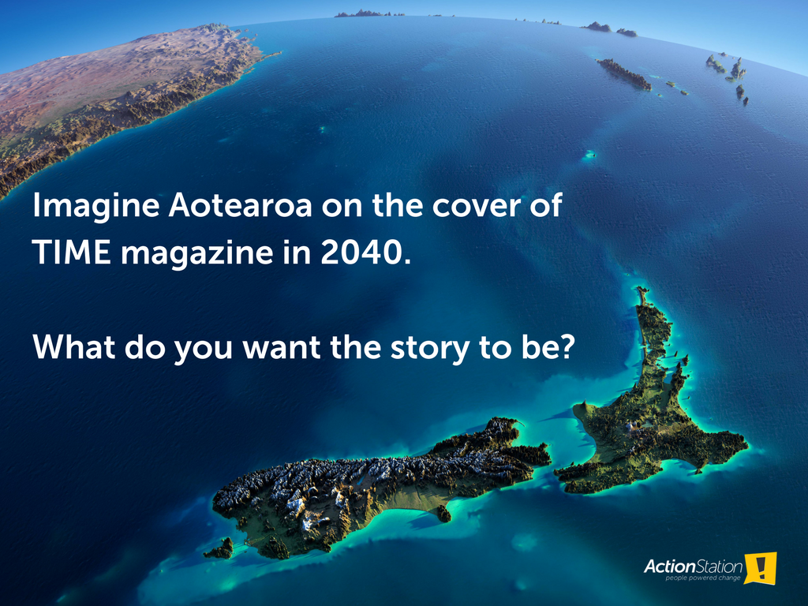

Slide 17


